Slide 1


Objectives
In this session, you will learn to:
Explore jQuery
Add visual effects using jQuery
Add visual effects using jQuery

Slide 2
Exploring jQuery
jQuery:
Is an open source and cross-browser library of JavaScript codes that was created to
make the JavaScript programming simpler.
Can be used to enhance the look and feel of a Web page.
Bridges the gap between extensive coding and Web designing.

Slide 3
Manipulating HTML Elements by Using jQuery
jQuery can be referred by downloading the light-weight jQuery JavaScript library.
Once the library is downloaded, it can be referred to in a Web page using the following syntax:
<SCRIPT type="text/javascript" src="<path>/jquery-1.8.3.js">
</SCRIPT>

Slide 4
Manipulating HTML Elements by Using jQuery (Contd.)
jQuery provides the document.ready() function for preventing failure of actions that should be performed on an HTML element.
The following syntax is used to specify the document.ready() function:
<SCRIPT type="text/javascript">
$(document).ready(function(){
// jquery code...
});
</SCRIPT>

Slide 5
Manipulating HTML Elements by Using jQuery (Contd.)
jQuery selectors:
Are used to select and manipulate the HTML.
jQuery selectors are used to "find" (or select) HTML elements based on their name, id, classes, types, attributes, values of attributes and much more. It's based on the existing CSS Selectors, and in addition, it has some own custom selectors.
All selectors in jQuery start with the dollar sign and parentheses: $().
The element Selector
Selects elements based on the element name.
The #id Selector
Uses the id attribute of an HTML tag to find the specific element.
An id should be unique within a page, so you should use the #id selector when you want to find a single, unique element.
The .class Selector
The jQuery class selector finds elements with a specific class.

Slide 6
Manipulating HTML Elements by Using jQuery (Contd.)
jQuery provides predefined functions to perform modifications on the content of HTML elements.
Some of the jQuery predefined functions are:
html()
remove()
after()
val()
empty()
append()
before()
attr()
text()
prepend()

Slide 7
Manipulating HTML Elements by Using jQuery (Contd.)
The following embedded Notepad file contains the code for modifying the inner
content of HTML elements:

Slide 8
Handling jQuery Events
In jQuery, events are handled by using the event methods.
An event method is used to detect an event and trigger a function when that event occurs.
Some of the event methods are:
$(document).load(function)
$(selector).click(function)
$(selector).dblclick(function)
$(selector).mouseenter(function)
$(selector).mouseleave(function)
$(selector).keydown(function)
$(selector).submit(function)
$(selector).focus(function)
$(selector).blur(function)
$(selector).resize(function)
$(selector).unload(function)
$(selector).mousedown(function)
$(selector).mouseup(function)

Slide 9
Adding Visual Effects Using jQuery
Visual effects:
Help to enrich the browsing experience of a user.
Are used to add visual appeal to a Web page.
Can be added using the following predefined jQuery effects:
Effects
Hide
Animate
Toggle
Show
Fade
Slide

Slide 10
Implementing Hide Effect
The hide() function:
Is used to make an element disappear when an event occurs.
Has the following syntax:
$(selector).hide(speed)
The following embedded Notepad file contains the code to implement the hide effect:

Slide 11
Implementing Show Effect
The show() function:
Is used to make a hidden element visible when an event occurs.
Has the following syntax:
$(selector).show(speed)
The following embedded Notepad file contains the code to implement the show effect:

Slide 12
Implementing Toggle Effect
The toggle() function:
Can be used to switch between the show and hide effects of an element.
Has the following syntax:
$(selector).toggle(speed)
The following embedded Notepad file contains the code to implement the toggle effect:

Slide 13
Implementing Slide Effect
The slide effect:
Can be used to produce a sliding effect on the selected elements.
Can be implemented using the following functions:
Methods
slideDown()
slideUp()
slideToggle()

Slide 14
Implementing Slide Effect (Contd.)
The following embedded Notepad file contains the code to implement the slide effect:

Slide 15
Implementing Fade Effect
The fade effect:
Is used to gradually reduce the opacity of the selected elements.
Can be implemented using the following functions:
Methods
fadeOut()
fadeIn()
fadeTo()
fadeToggle()

Slide 16
Implementing Animate Effect
The animate effect:
Is used to create custom animations.
Is implemented using the animate() function having the following syntax:
animate({params},speed,callback);
The following embedded Notepad file contains the code to implement the animate effect:

Slide 17
jQuery - Chaining
With jQuery, you can chain together actions/methods.
Chaining allows us to run multiple jQuery methods (on the same element) within a single statement.
There is a technique called chaining, that allows us to run multiple jQuery commands, one after the other, on the same element(s).
To chain an action, you simply append the action to the previous action.

Slide 18
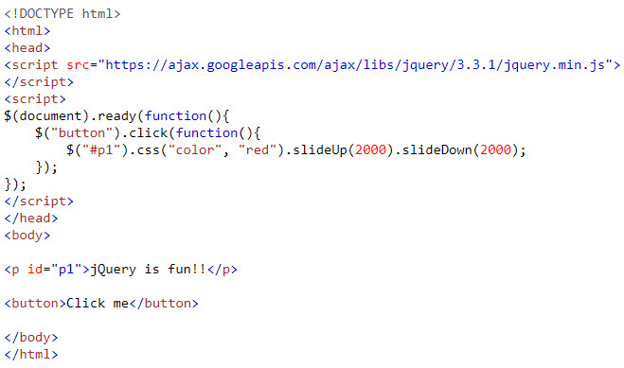
jQuery - Chaining
Example:

Slide 19
jQuery Manipulating CSS
jQuery has several methods for CSS manipulation.
addClass() - Adds one or more classes to the selected elements
removeClass() - Removes one or more classes from the selected elements
toggleClass() - Toggles between adding/removing classes from the selected elements
css() - Sets or returns the style attribute

Slide 20
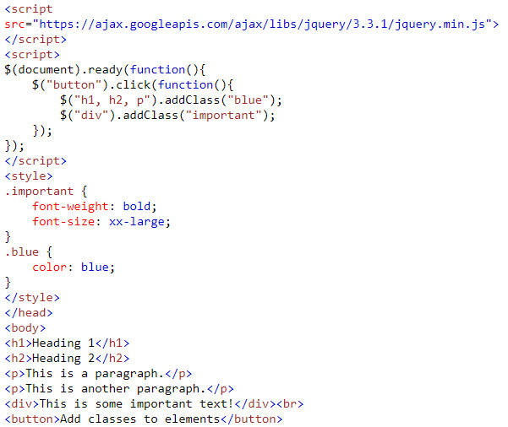
jQuery Manipulating CSS
Example:

Slide 21
Demo
Teacher demo jQuery effects to students

Slide 22
Summary
In this session, you learned that:
jQuery is an open source and cross-browser library of JavaScript codes that was created to make the JavaScript programming simpler.
jQuery can be referred by downloading the light-weight jQuery JavaScript library.
jQuery provides the document.ready() function for preventing failure of actions that should be performed on an HTML element.
jQuery selectors are used to select and manipulate the HTML elements.
An event method is used to detect an event and trigger a function when that event occurs.
Visual effects help to enrich the browsing experience of a user.
The hide() function is used to make an element disappear when an event occurs.
The show() function is used to make a hidden element visible when an event occurs.
The toggle() function can be used to switch between the show and hide effects of an element.
The slide effect can be used to produce a sliding effect on the selected elements.

